Slide 1
Sets and Maps

Slide 2
Definitions
A set is a data structure to store and process nonduplicate elements.
A map provides a dictionary like scheme to lookup and retrieve a value using a key.

Slide 3
Sets
You can create a set using one of three concrete classes:
HashSet
LinkedHashSet
TreeSet

Slide 4
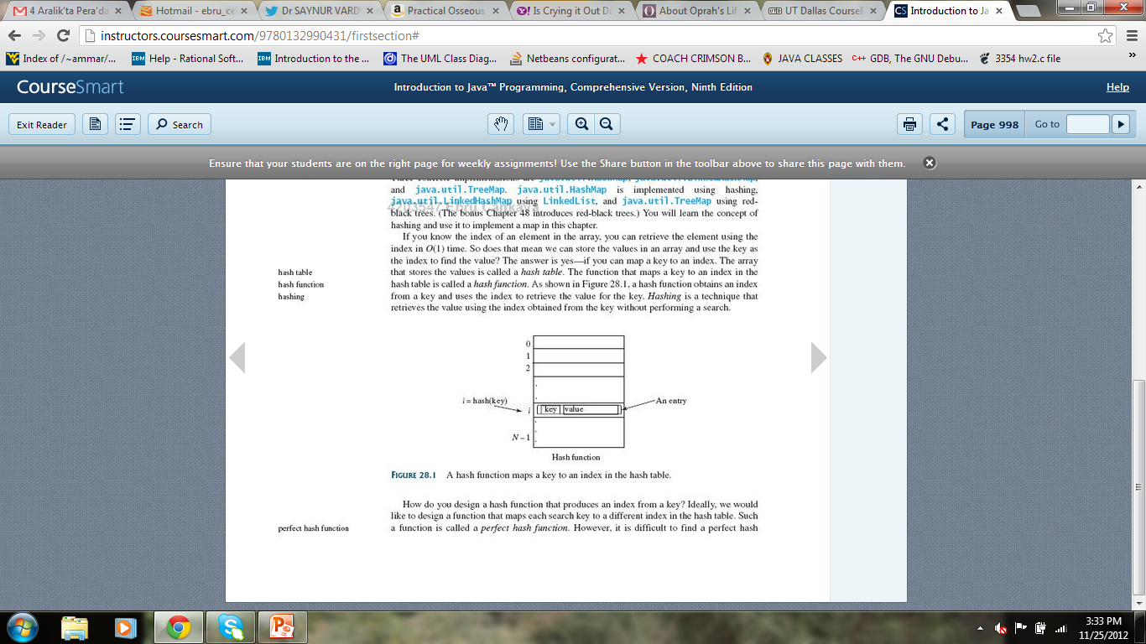
What is Hashing?
Hashing uses a hash function to map a key to an index so that the value at the index is retrieved in O(1) time.
A hash function first
converts a search key
to an integer value
(hash code), then
compresses hash code
into an index to the hash table.

Slide 5
Hash Collusion
Hash collusion is a problem that occurs when the hash function yields the same index with two different search keys.
Solution:
Use open addressing: Finding an open location in the hash table in the event of a collusion.
Three variations: Linear probing, quadratic probing, double hashing.
Use separate chaining: Places all entries with the same hash index in the same location, rather than finding new locations.

Slide 6
Hash Codes for Primitive Types
byte, short, int, char: Typecast these types into int so that no collusions (or minimal collusions) will occur.
float: use Float.floatToIntBits(key) as the hash code.
long: typecasting into int won’t be sufficient, b/c all keys that differ in only the first 32 bits will have the same hash code. To take the first 32 bits into consideration, perform folding: divide 64-bits into two halves and XOR these halves.

Slide 7
Hash Codes for Primitive Types
double: convert the search key into long using Double.doubleToLongBits method, then perform folding.

Slide 8
Hash Code for Strings
Intuitively, sum the Unicode of all characters as the hash code for the string.
What if we calculate the hash code for two words as eat and ate?
Better, take character positions into consideration as well.

Slide 9
Compressing Hash Codes
The hash code for a key can be a large integer that exceeds the boundary of the hash table.
Assume the index for a hash table is between 0 and N-1. Then, the hash code should be s.t.
h(hashCode)=hashCode % N
N is set to a power of 2 so that the above equation becomes
h(hashCode)=hashCode & (N-1), where & is the bitwise AND

Slide 10
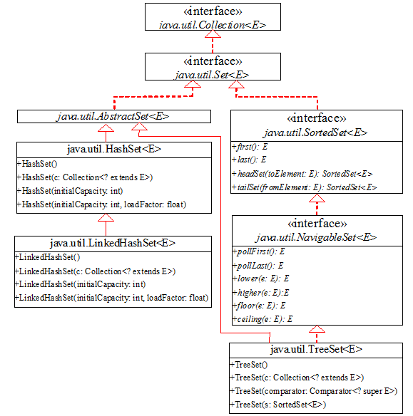
Set Interface Hierarchy

Slide 11
HashSet
Is a concrete class that implements Set interface.
Initial capacity is 16
Load factor: is the upper limit allowed, before increasing (doubling) the capacity of the set. It’s a value between 0.0-1.0 (usually 0.75)
There is no particular ordering of elements inserted into a HashSet.

Slide 12
LinkedHashSet
Extends HashSet with a linked list implementation.
It preserves the order in which the elements are inserted.

Slide 13
TreeSet
SortedSet is a subinterface of Set.
It guarantees that the elements in the set are sorted.
first(): returns the first element in the set
last(): returns the last element in the set
headSet(toElement): returns the portion of the set whose elements are less than toElement
tailSet(fromElement): returns the portion of the set whose elements are greater than or equal to fromElement

Slide 14
TreeSet
NavigableSet is a subinterface of SortedSet to provide navigation methods.
lower(e): returns elements less than a given element e.
floor(e): returns elements less than or equal to a given element e.
ceiling(e): returns elements greater than or equal to a given element e.
higher(e): returns elements greater than a given element e.
pollFirst(): remove and return the first element in the tree.
pollLast(): remove and return the last element in the tree.

Slide 15
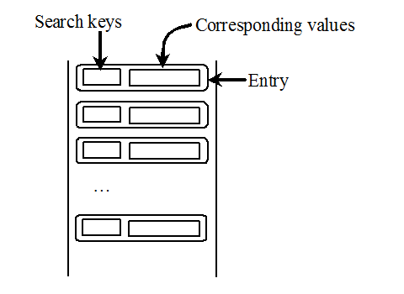
The Map Interface
The Map interface maps keys to the elements. The keys are like indexes. In List, the indexes are integer. In Map, the keys can be any objects.

Slide 16
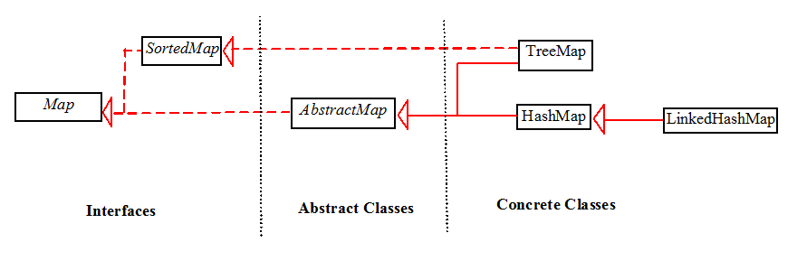
Map Interface and Class Hierarchy
An instance of Map represents a group of objects, each of which is associated with a key. You can get the object from a map using a key, and you have to use a key to put the object into the map.

Slide 17
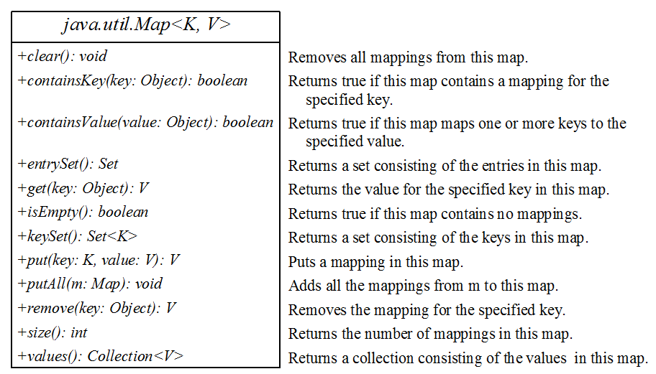
The Map Interface UML Diagram

Slide 18
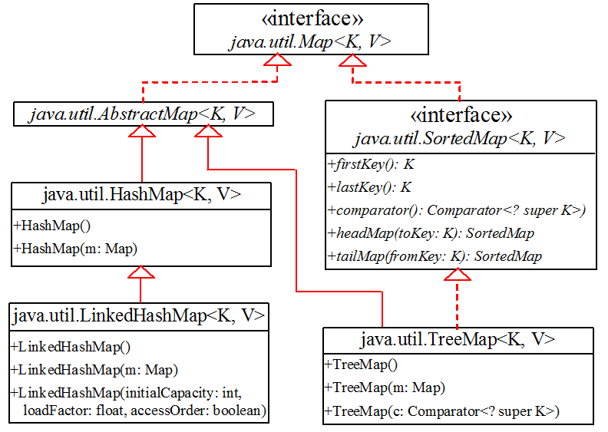
Concrete Map Classes

Slide 19
HashMap and TreeMap
The HashMap and TreeMap classes are two concrete implementations of the Map interface.
The HashMap class is efficient for locating a value, inserting a mapping, and deleting a mapping.
The TreeMap class, implementing SortedMap, is efficient for traversing the keys in a sorted order.

Slide 20
LinkedHashMap
LinkedHashMap extends HashMap with a linked list implementation that supports an ordering of the entries in the map.
The entries in a HashMap are not ordered, but the entries in a LinkedHashMap can be retrieved in:
insertion order: the order in which they were inserted into the map. The no-arg constructor constructs a LinkedHashMap with the insertion order.
access order: the order in which they were last accessed, from least recently accessed to most recently. To construct a LinkedHashMap with the access order, use the LinkedHashMap(initialCapacity, loadFactor, true).

